Slide 1
RNN ACC
許躍薾
陳品穎

Slide 2
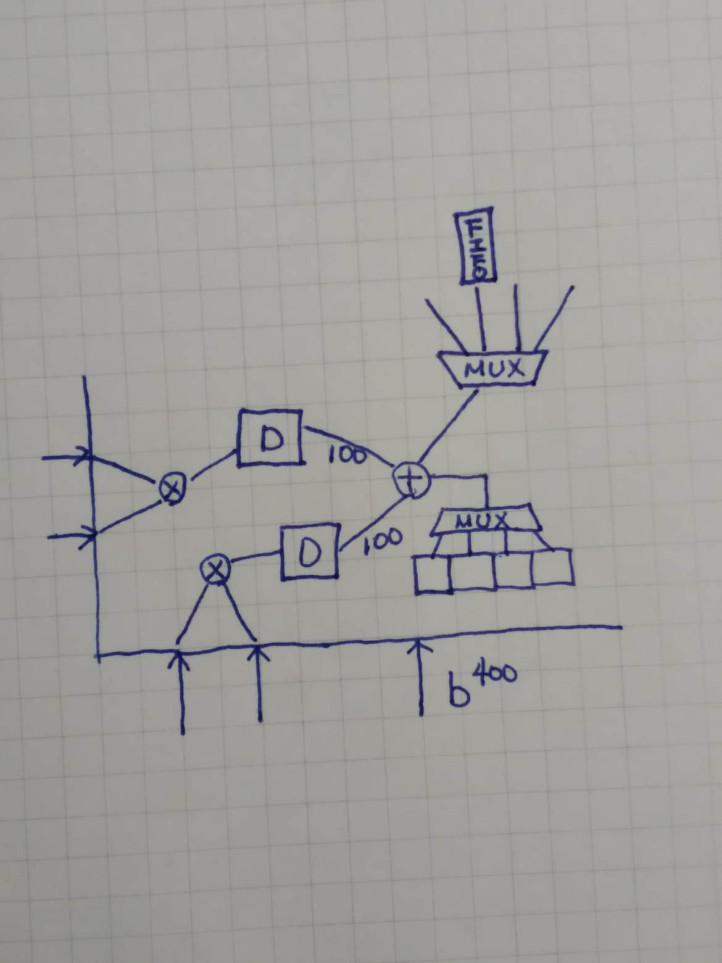
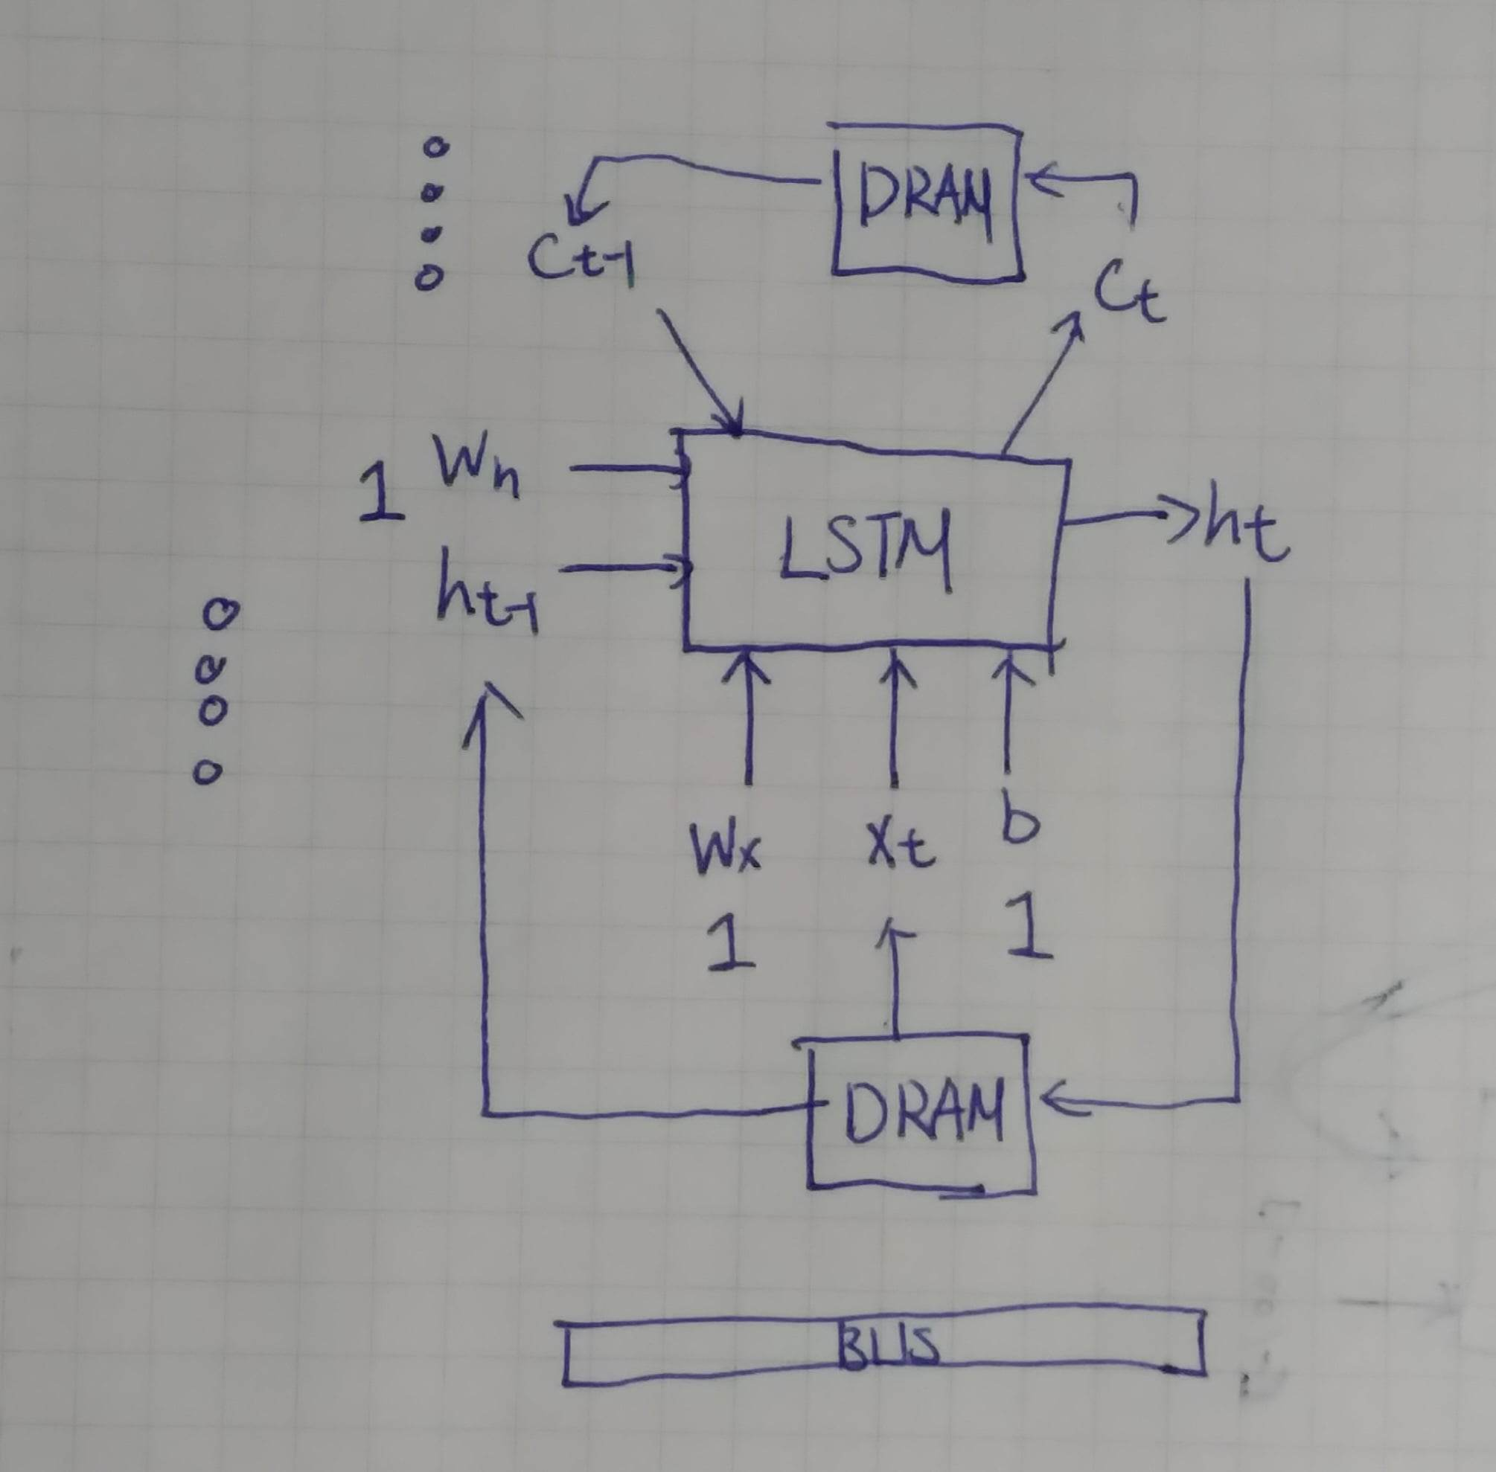
OVERVIEW
Notes:
畫首圖

Slide 3
PREV-PROBLEM
why use 16 bit data?
what is the h/w struct? it is unclear.
is the tanh 精準?
對RNN之瞭解不足
Notes:
對於不清楚的軟硬體架構，我們以於前一張投影片中解釋 對於RNN之瞭解不足部分，將以我們以軟體應用實例來展示此硬體加速器並非全然虛構，有實際應用之處，並可有實際產出，如下述:

Slide 4

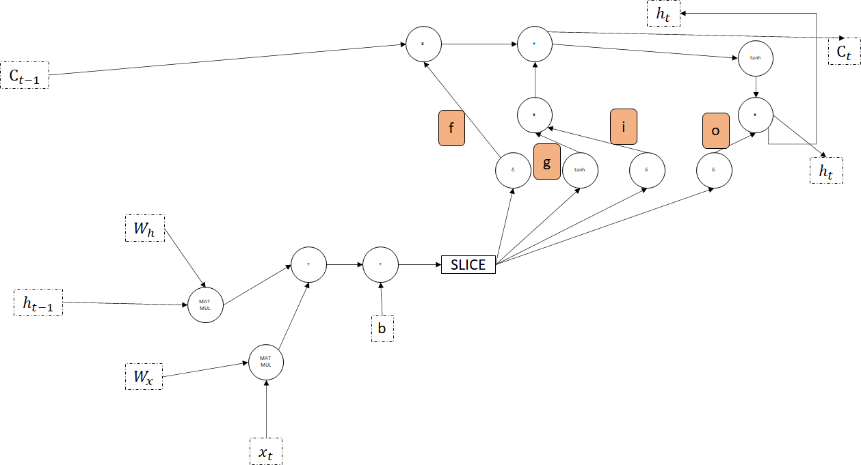
SOFTWARE LAYER
Notes:
畫軟體說明圖

Slide 5
user input
1 提示字
此字作為生成文章的起始字詞
生成文章長度:100字
可調?TBD...

Slide 6

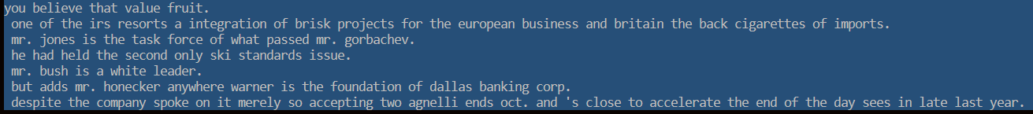
main function
LSTM生成文章

Slide 7
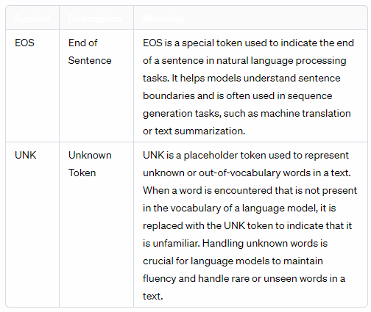
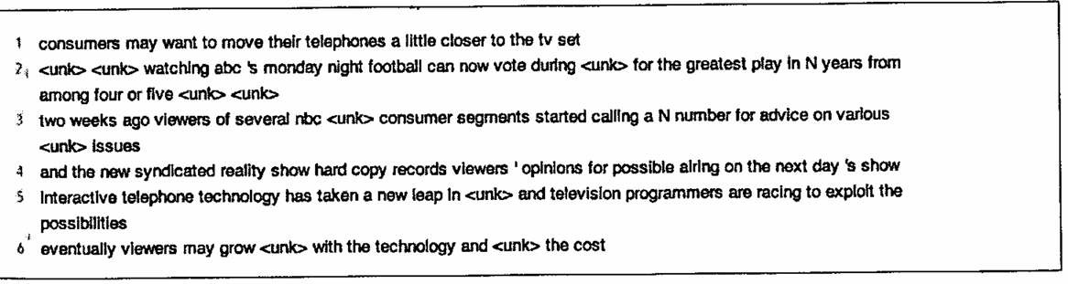

Training data

Slide 8
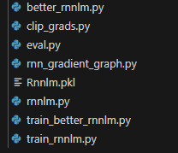
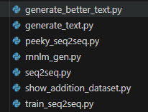
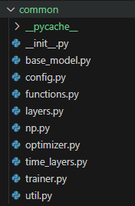
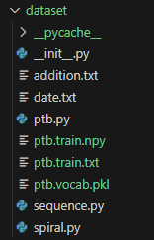
軟體架構
RNN
生成文字
功能單元
資料集

Slide 9
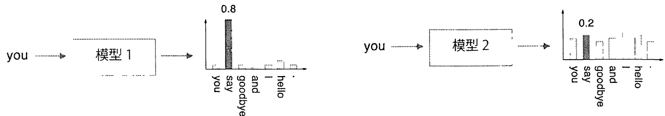
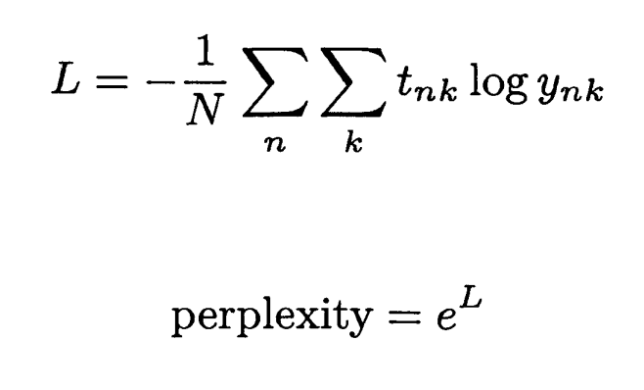
評估結果的方法

Slide 10
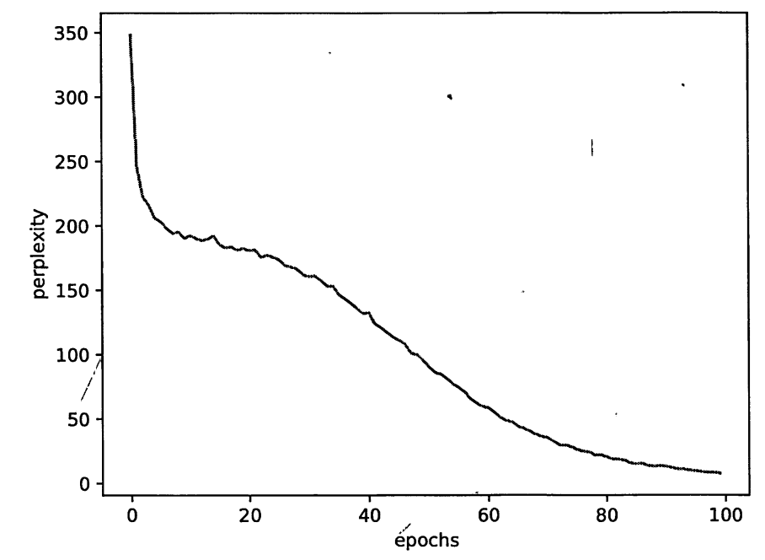
軟體訓練結果
將比較軟體分數
與
硬體加速後分數

Slide 11
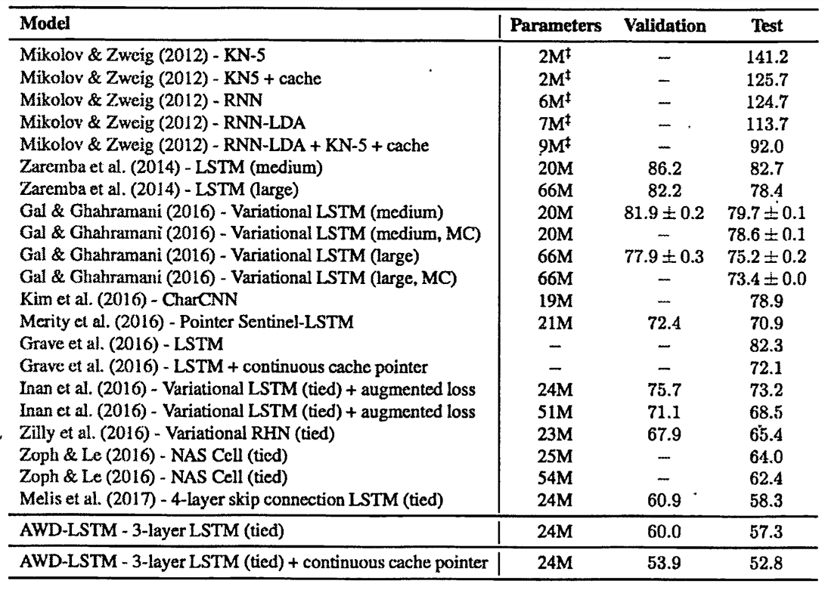
其他人的分數
疑惑度173
因模型較簡易
故分數未達50
分數較低者優

Slide 12
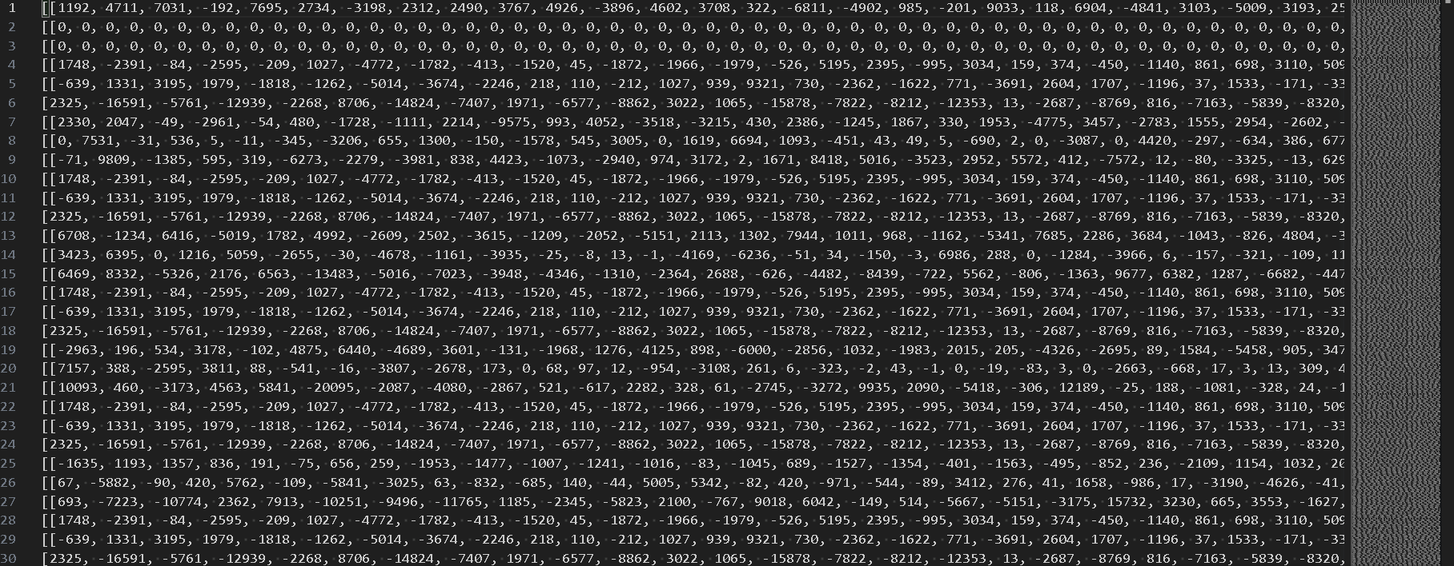
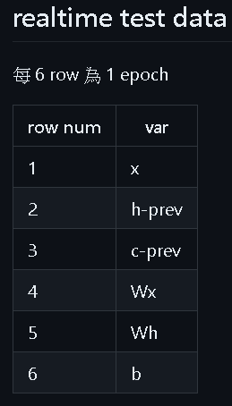
軟硬體介面

Slide 13
位元數的取捨
float
-5
+5
int
2147483647
-2147483648
Int16_10^8
1->10^8
-1->-10^8

Slide 14

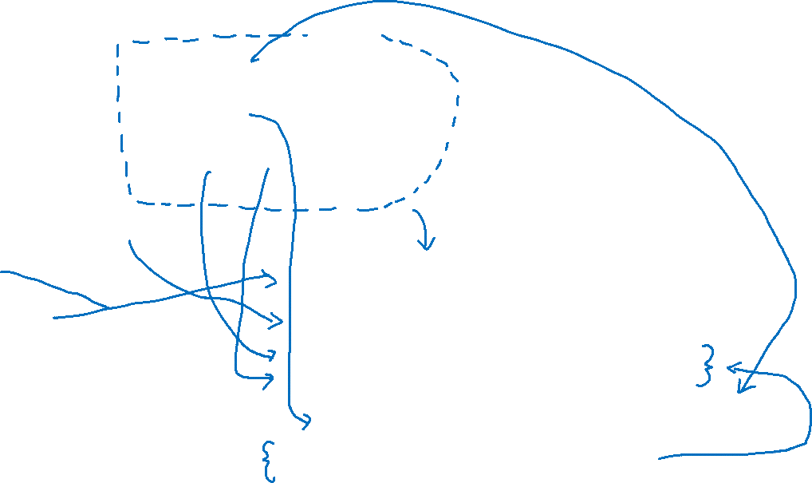
硬體的初步實踐
cp ../module/fgio.sv .
cp ../tool/B_matrix_times_vector_genED_M_100_400_V_100.sv .
cp ../tool/matrix_times_vector_genED_M_100_400_V_100.sv .
cp ../tool/vector_add_vector_genED_M_100_400_X_400.sv .
cp ../module/long_non_linear_shape_100_400_sigmoid.sv .
cp ../module/long_non_linear_shape_100_400_tanh.sv .
cp ../tool/vector_add_vector_genED_X_100_400_V_100.sv .
cp ../tool/vector_mul_vector_genED_M_100_400_V_100.sv .
cp ../sigmoid_module_workspace/sigmoid.sv .
cp ../tanh_module_workspace/tanh.sv .

Slide 15

Tanh-接線

Slide 16
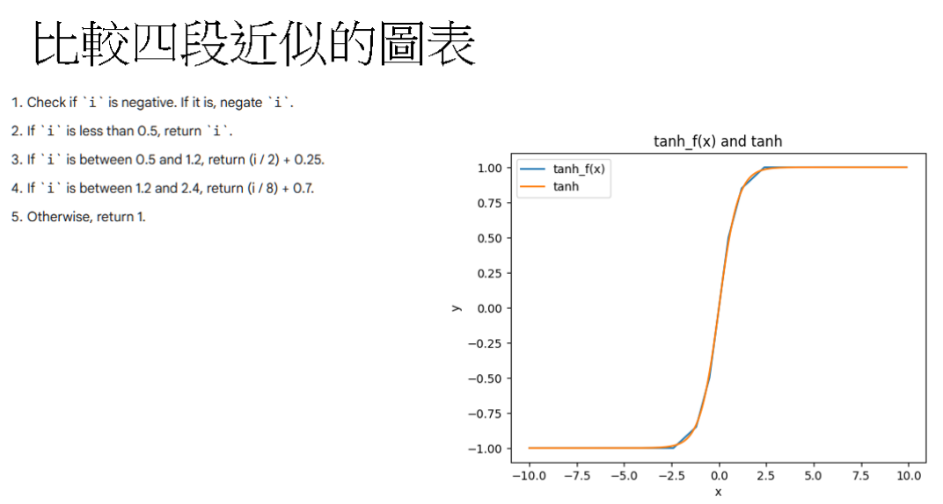

Slide 17
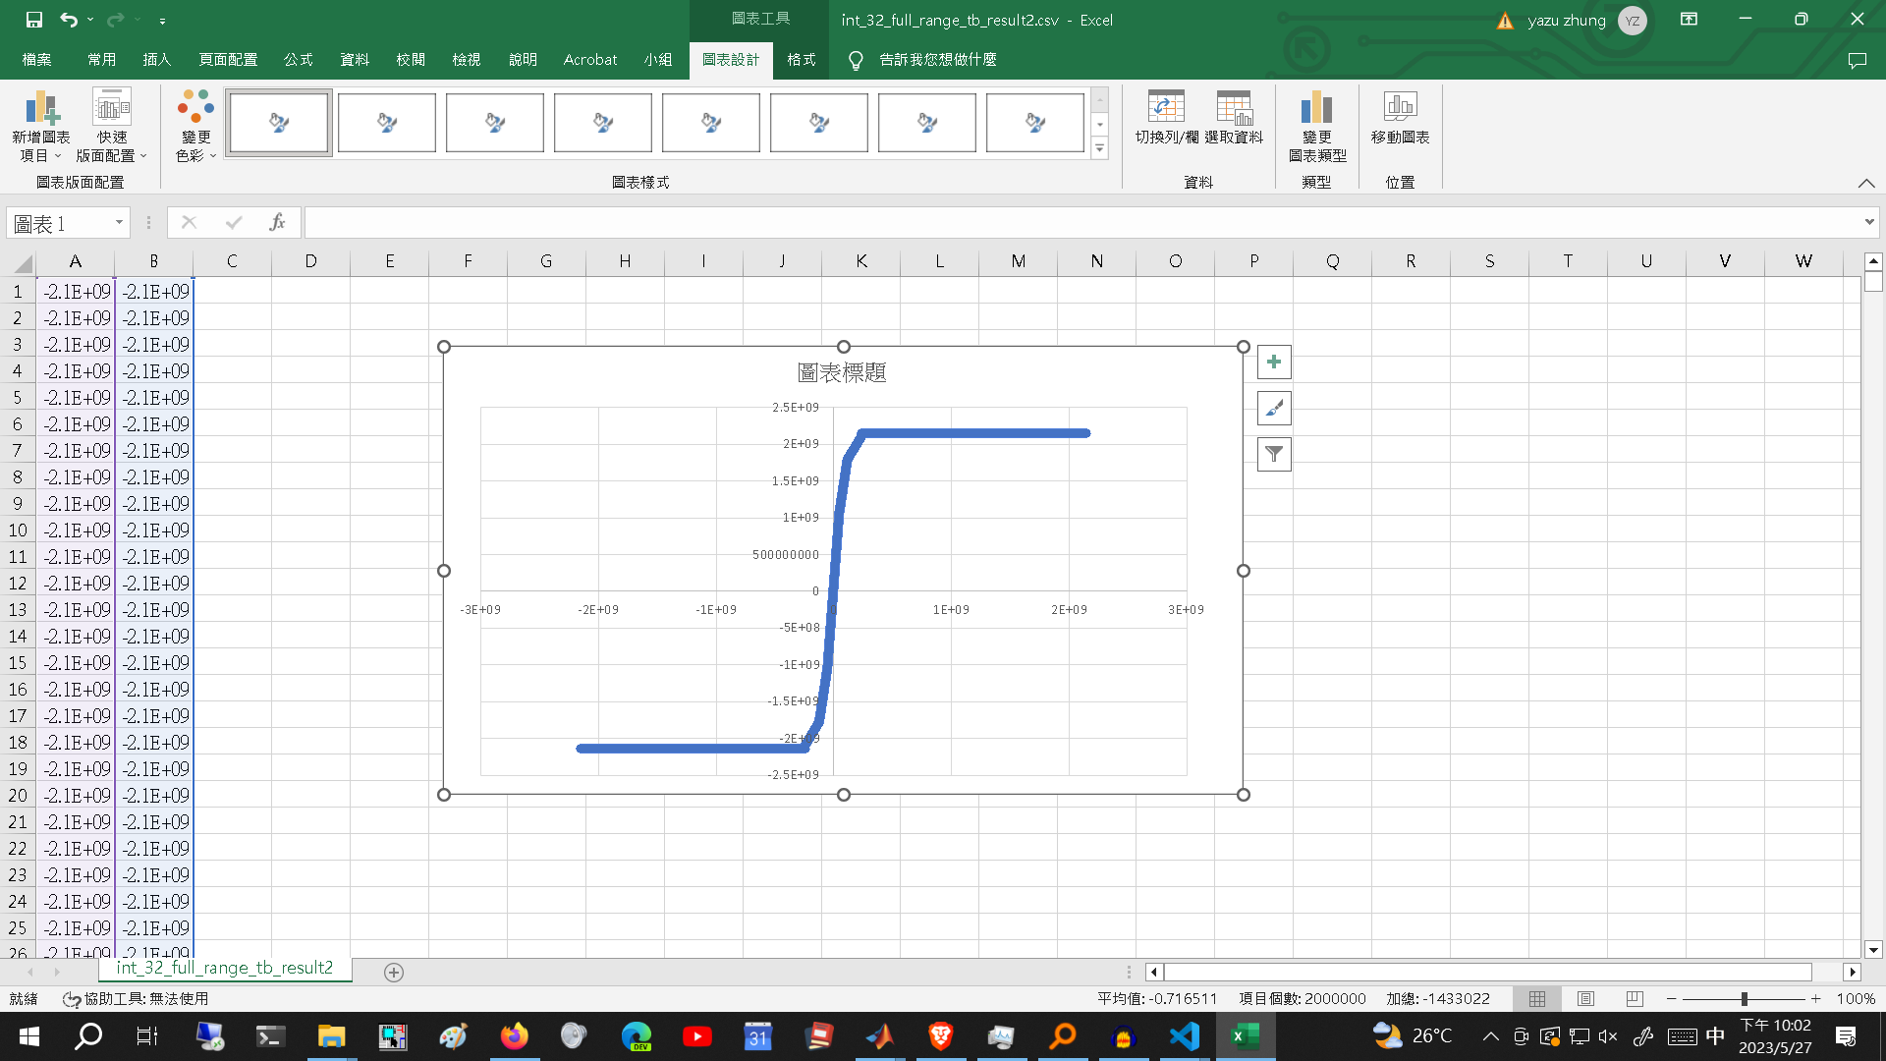
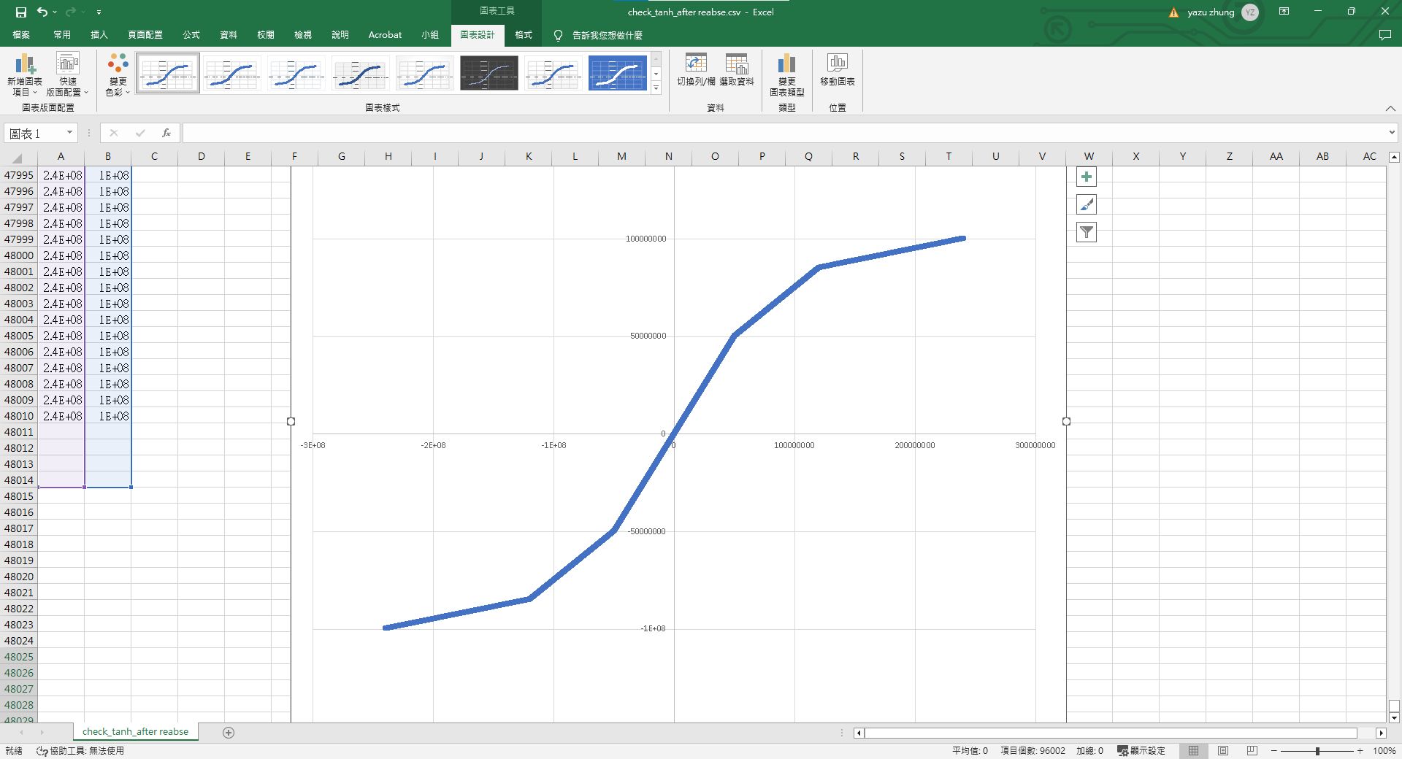
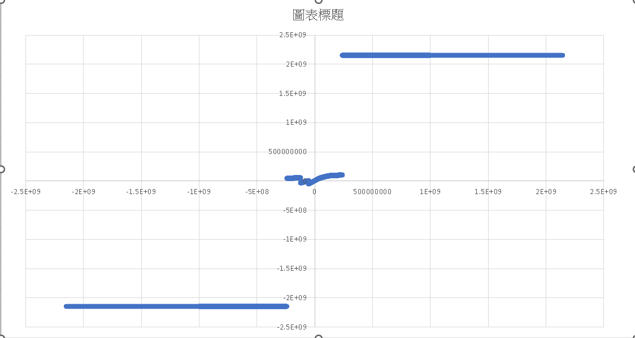
Tanh-驗證

Slide 18
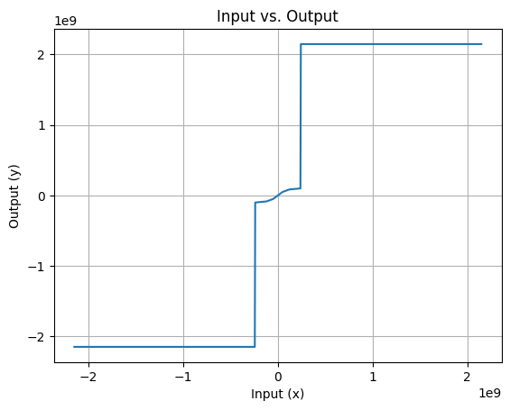
Tanh-困難與挑戰

Slide 19

Tanh-功耗與面積
design | design_name | config | flow_status | total_runtime | routed_runtime | (Cell/mm^2)/Core_Util | DIEAREA_mm^2 | CellPer_mm^2 | OpenDP_Util
/content | tanh | RUN_2023.06.12_11.39.23 | flow failed | 1h12m51s0ms | 0h4m41s0ms | 1060 | 4 | 530 | -1
Magic_violations | pin_antenna_violations | net_antenna_violations | lvs_total_errors | cvc_total_errors | klayout_violations | wire_length | vias | wns | pl_wns
0 | 22 | 21 | 0 | -1 | -1 | 1533096 | 19167 | -9.83 | -1
routing_layer1_pct | routing_layer2_pct | routing_layer3_pct | routing_layer4_pct | routing_layer5_pct | routing_layer6_pct | wires_count | wire_bits | public_wires_count | public_wire_bits
0 | 53.86 | 58.87 | 19.88 | 32.06 | -1 | 2144 | 2237 | 3 | 96
XOR | XNOR | MUX | inputs | outputs | level | DecapCells | WelltapCells | DiodeCells | FillCells
456 | 178 | 126 | 32 | 32 | 25 | 14428 | 6102 | 491 | 8473
power_fastest_internal_uW | power_fastest_switching_uW | power_fastest_leakage_uW | critical_path_ns | suggested_clock_period | suggested_clock_frequency | CLOCK_PERIOD | FP_ASPECT_RATIO | FP_CORE_UTIL | FP_PDN_HPITCH
-1 | -1 | -1 | 102 | 106.25 | 9.4117647 | 10 | 1 | 50 | 25
Final_Util | Peak_Memory_Usage_MB | synth_cell_count | tritonRoute_violations | Short_violations | MetSpc_violations | OffGrid_violations | MinHole_violations | Other_violations
-1 | 909.29 | 1480 | 0 | 0 | 0 | 0 | 0 | 0
optimized_wns | fastroute_wns | spef_wns | tns | pl_tns | optimized_tns | fastroute_tns | spef_tns | HPWL
-1 | -1 | -96.25 | -287.62 | -1 | -1 | -1 | -2590.76 | -1
memories_count | memory_bits | processes_count | cells_pre_abc | AND | DFF | NAND | NOR | OR
0 | 0 | 0 | 2173 | 56 | 0 | 33 | 211 | 306
NonPhysCells | TotalCells | CoreArea_um^2 | power_slowest_internal_uW | power_slowest_switching_uW | power_slowest_leakage_uW | power_typical_internal_uW | power_typical_switching_uW | power_typical_leakage_uW
2120 | 31614 | 954839.56 | -1 | -1 | -1 | 0.0193 | 0.149 | 7.95E-07
FP_PDN_VPITCH | GRT_ADJUSTMENT | GRT_REPAIR_ANTENNAS | PL_TARGET_DENSITY | RUN_HEURISTIC_DIODE_INSERTION | STD_CELL_LIBRARY | SYNTH_MAX_FANOUT | SYNTH_STRATEGY
25 | 0.3 | 1 | 0.75 | 0 | gf180mcu_fd_sc_mcu7t5v0 | 10 | AREA 0

Slide 20

sigmoid-接線

Slide 21
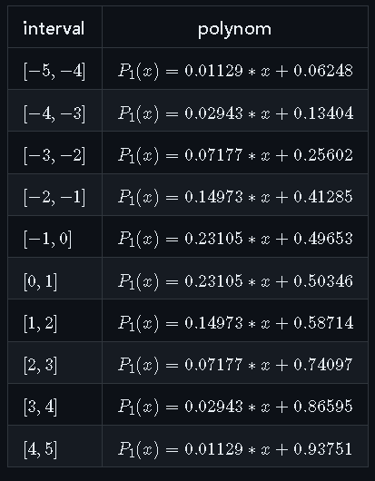
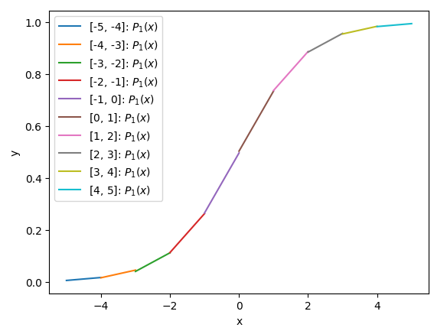
sigmoid-邏輯
https://ieeexplore.ieee.org/document/997519

Slide 22
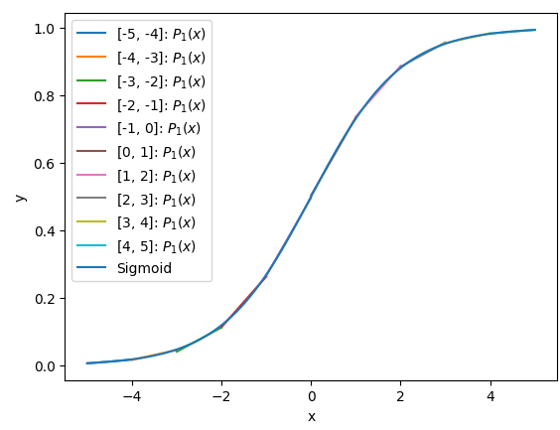
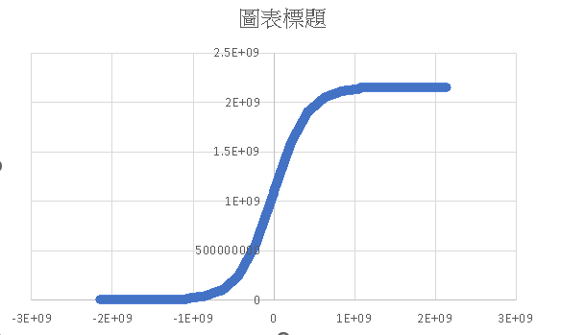
sigmoid-驗證

Slide 23
sigmoid-困難與挑戰

Slide 24

sigmoid-功耗與面積
design | design_name | config | flow_status | total_runtime | routed_runtime | (Cell/mm^2)/Core_Util | DIEAREA_mm^2 | CellPer_mm^2 | OpenDP_Util
/content | sigmoid | RUN_2023.06.12_13.03.28 | flow failed | 0h54m42s0ms | 0h2m27s0ms | 440.5 | 4 | 220.25 | -1
Final_Util | Peak_Memory_Usage_MB | synth_cell_count | tritonRoute_violations | Short_violations | MetSpc_violations | OffGrid_violations | MinHole_violations | Other_violations | Magic_violations
-1 | 816.26 | 291 | 0 | 0 | 0 | 0 | 0 | 0 | 0
pin_antenna_violations | net_antenna_violations | lvs_total_errors | cvc_total_errors | klayout_violations | wire_length | vias | wns | pl_wns | optimized_wns
7 | 7 | 0 | -1 | -1 | 336281 | 3346 | -5.38 | -1 | -1
fastroute_wns | spef_wns | tns | pl_tns | optimized_tns | fastroute_tns | spef_tns | HPWL | routing_layer1_pct | routing_layer2_pct
-1 | -36.12 | -100.15 | -1 | -1 | -1 | -837.86 | -1 | 0 | 15.28
routing_layer3_pct | routing_layer4_pct | routing_layer5_pct | routing_layer6_pct | wires_count | wire_bits | public_wires_count | public_wire_bits | memories_count | memory_bits
15.86 | 0.04 | 0.42 | -1 | 559 | 621 | 2 | 64 | 0 | 0
processes_count | cells_pre_abc | AND | DFF | NAND | NOR | OR | XOR | XNOR | MUX
0 | 587 | 27 | 0 | 35 | 58 | 105 | 10 | 0 | 0
inputs | outputs | level | DecapCells | WelltapCells | DiodeCells | FillCells | NonPhysCells | TotalCells | CoreArea_um^2
32 | 30 | 13 | 12958 | 6102 | 148 | 6890 | 881 | 26979 | 954839.5584
power_slowest_internal_uW | power_slowest_switching_uW | power_slowest_leakage_uW | power_typical_internal_uW | power_typical_switching_uW | power_typical_leakage_uW | power_fastest_internal_uW | power_fastest_switching_uW | power_fastest_leakage_uW | critical_path_ns
-1 | -1 | -1 | 0.00089 | 0.00488 | 6.16E-07 | -1 | -1 | -1 | 41.87
suggested_clock_period | suggested_clock_frequency | CLOCK_PERIOD | FP_ASPECT_RATIO | FP_CORE_UTIL | FP_PDN_HPITCH | FP_PDN_VPITCH | GRT_ADJUSTMENT | GRT_REPAIR_ANTENNAS | PL_TARGET_DENSITY
46.12 | 21.68256722 | 10 | 1 | 50 | 25 | 25 | 0.3 | 1 | 0.75
RUN_HEURISTIC_DIODE_INSERTION | STD_CELL_LIBRARY | SYNTH_MAX_FANOUT | SYNTH_STRATEGY
0 | gf180mcu_fd_sc_mcu7t5v0 | 10 | AREA 0

Slide 25
noc 矩陣乘法器-單元IO
Vec1_32bit_array_len_100
X vec2_32bit_array_len_100
array_32bit_array_len_400*100

Slide 26
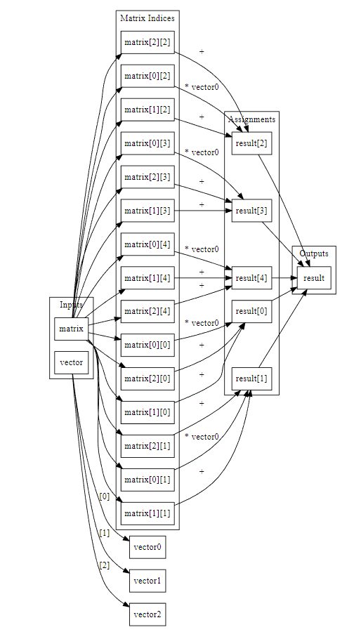
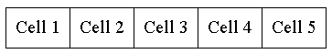
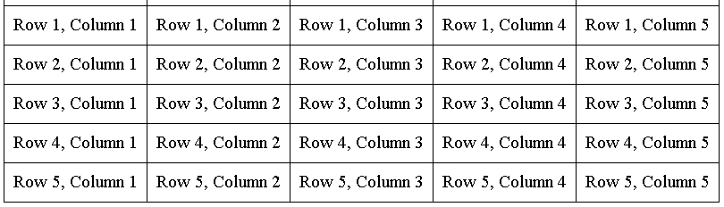
noc 矩陣乘法器-接線

Slide 27
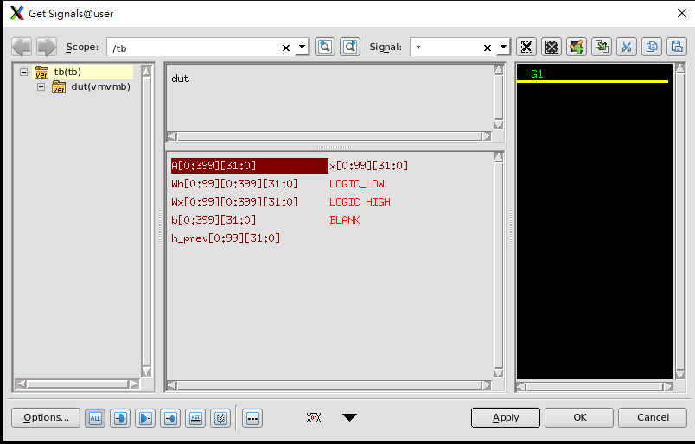
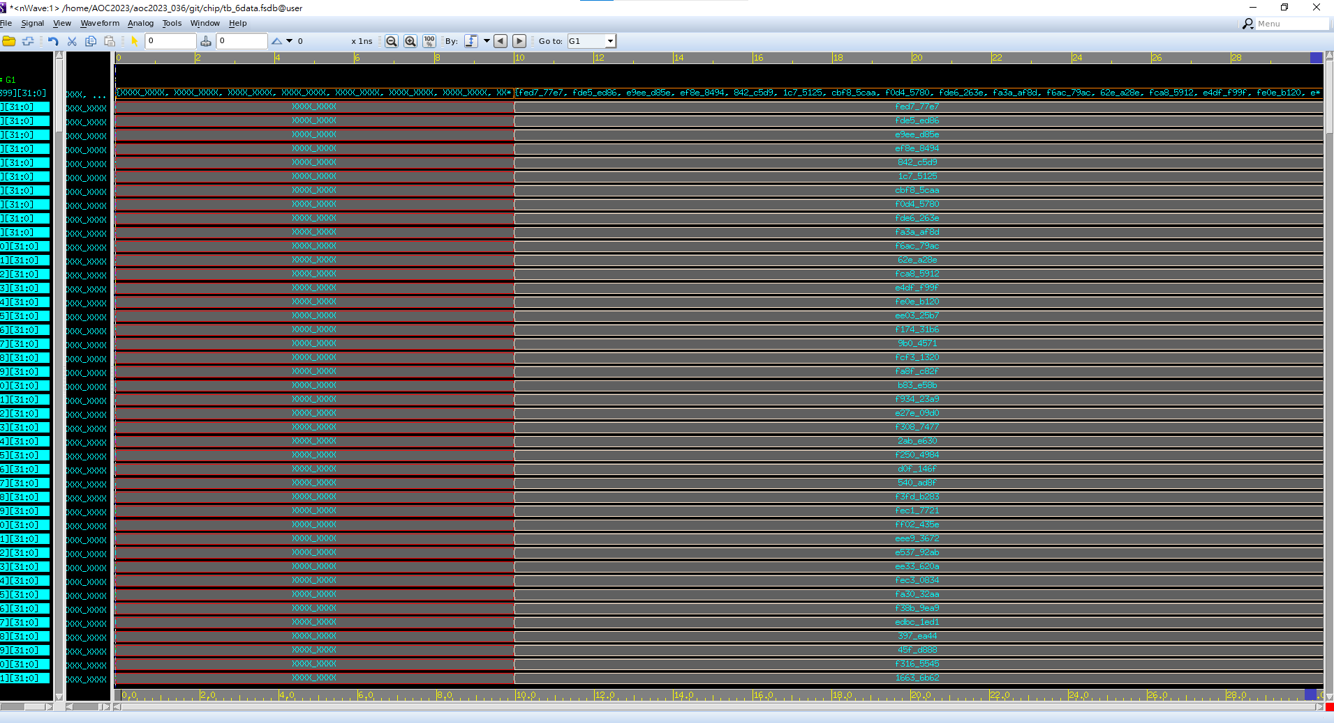
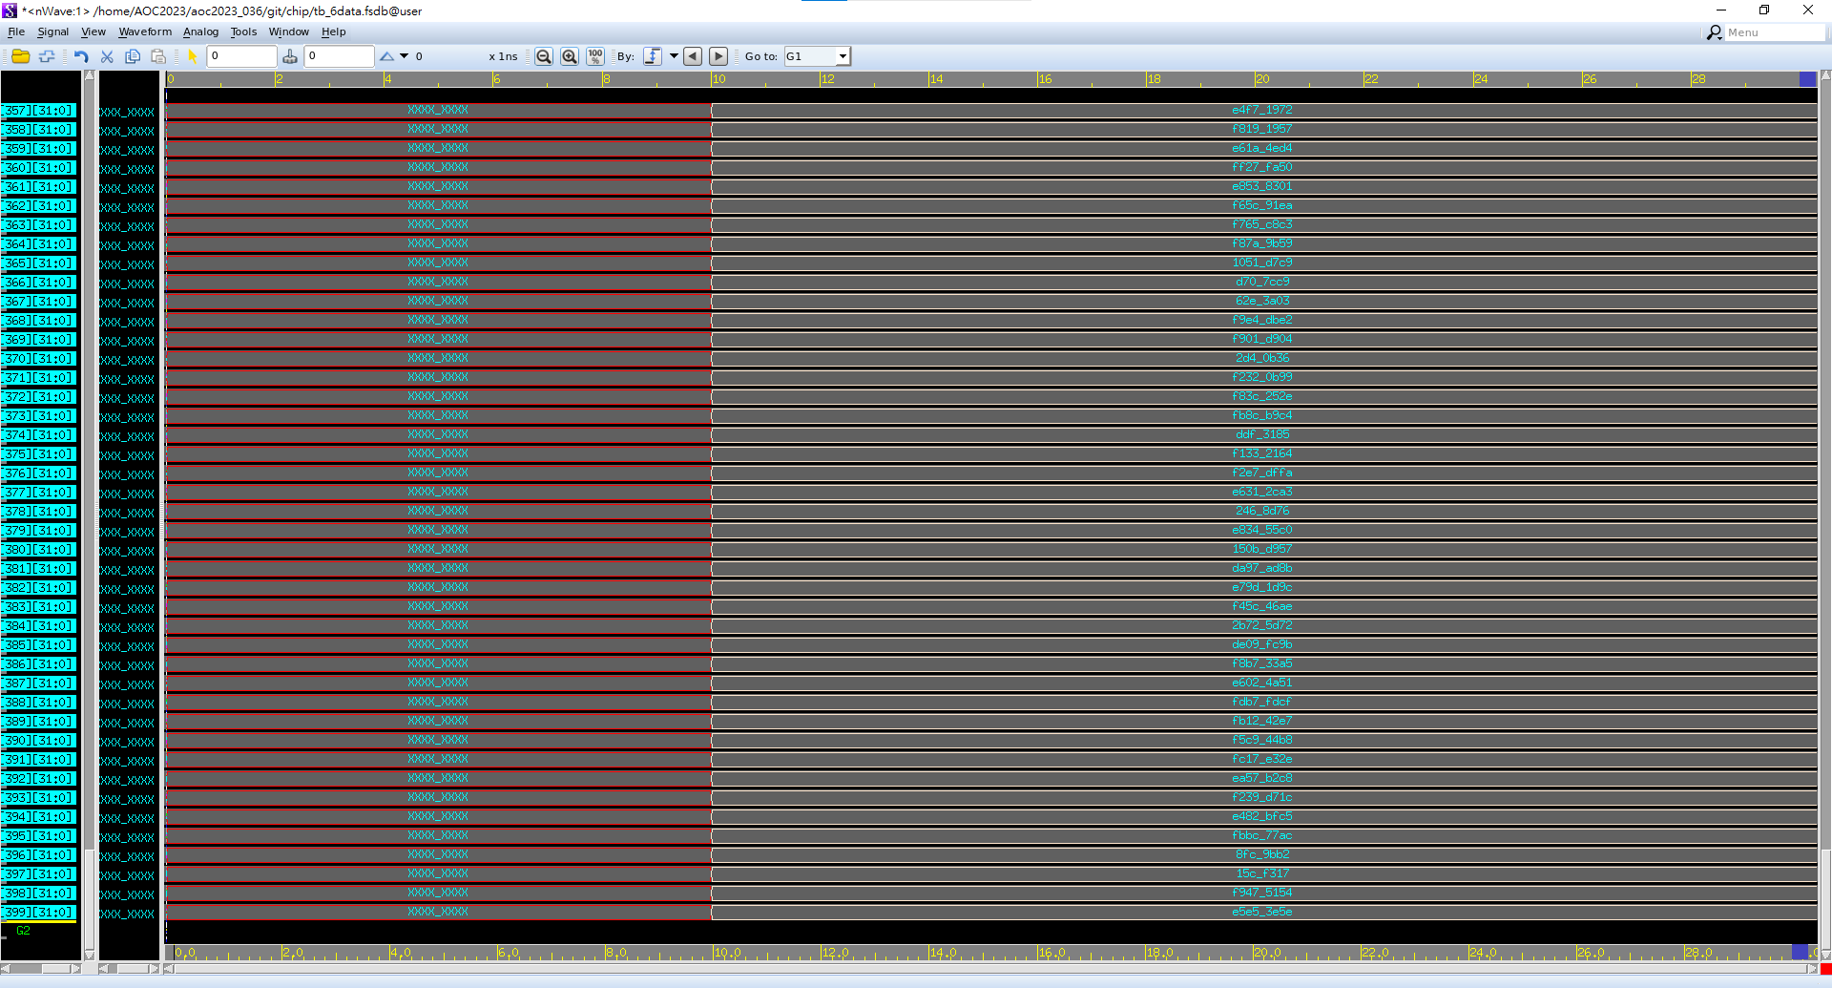
noc 矩陣乘法器-驗證

Slide 28
noc 矩陣乘法器-改進空間
用控制縮短面積，用時間去換

Slide 29
向量加法器-單元IO
Vec1_32bit_array_len_100/400
+ vec3_32bit_array_len_100/400
Vec2_32bit_array_len_100/400

Slide 30
向量加法器-接線

Slide 31
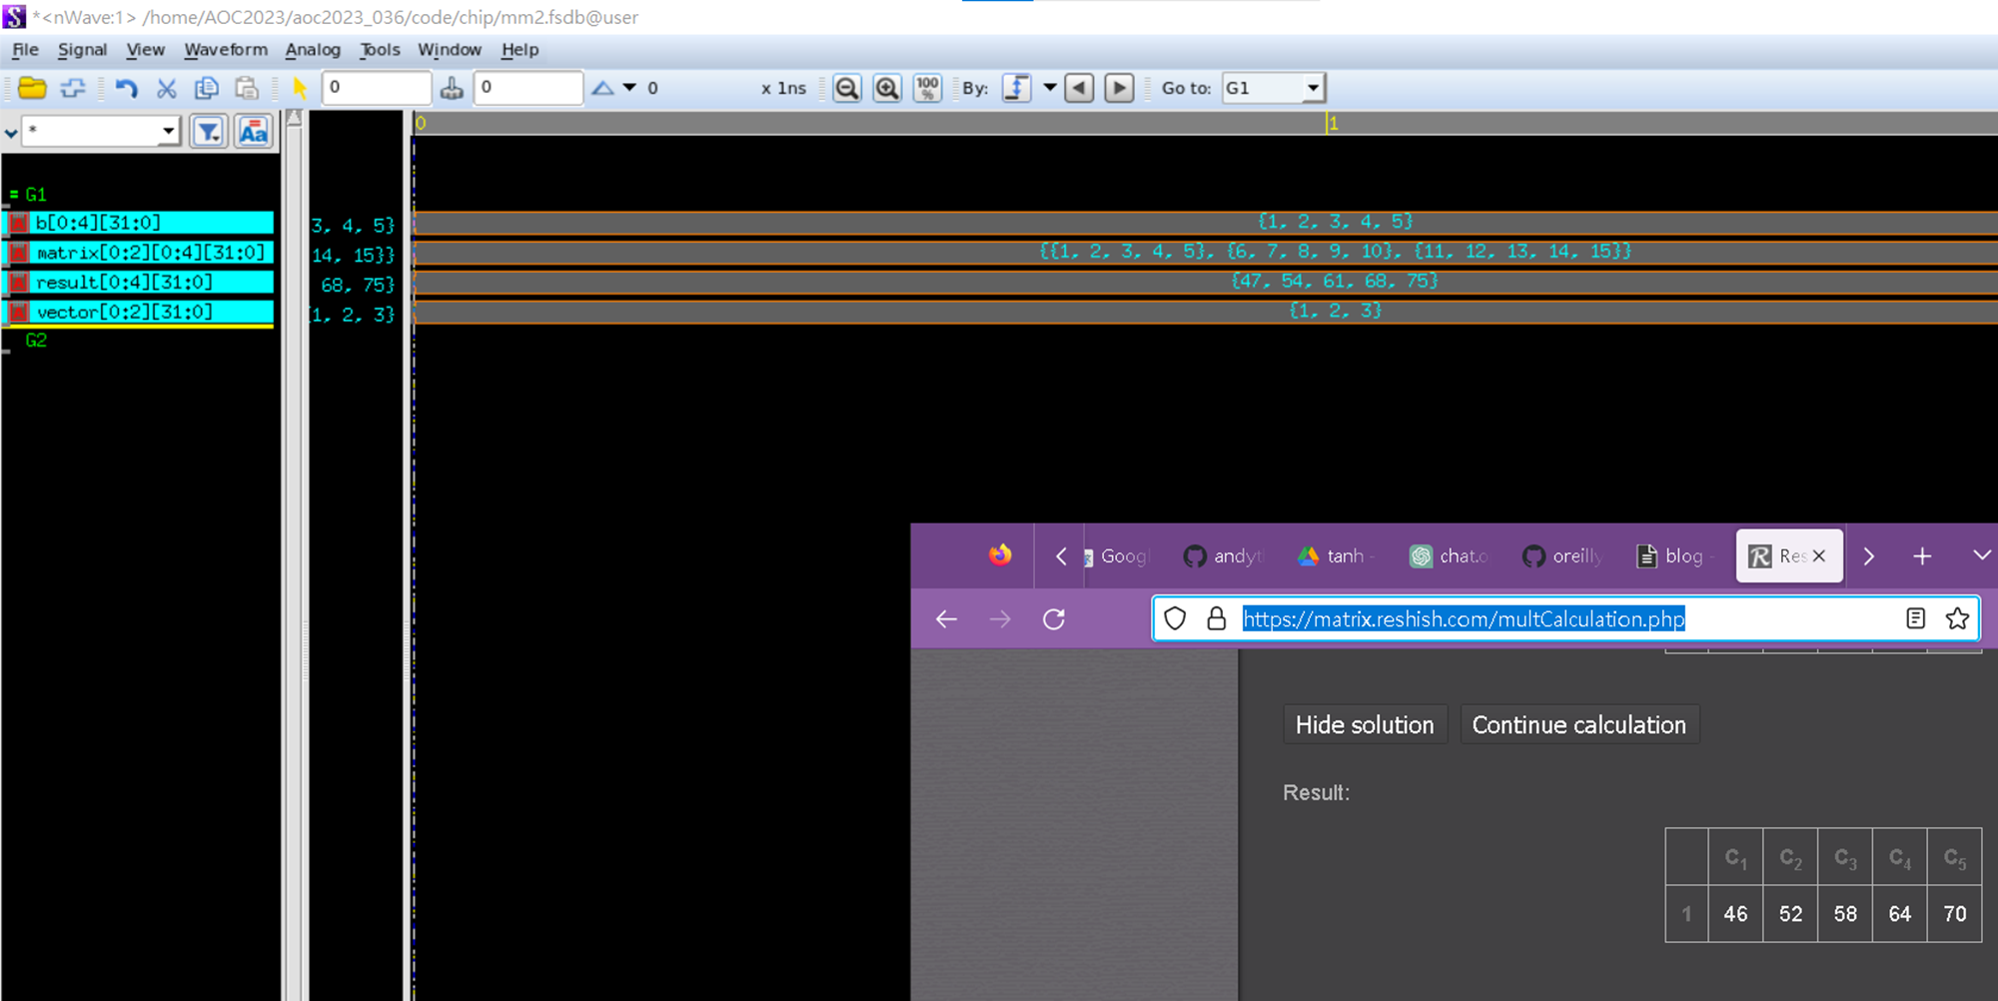
向量加法器-驗證
Notes:
https://hackmd.io/oMyZzflqT6amguTnJ4ZhAw#add-b

Slide 32
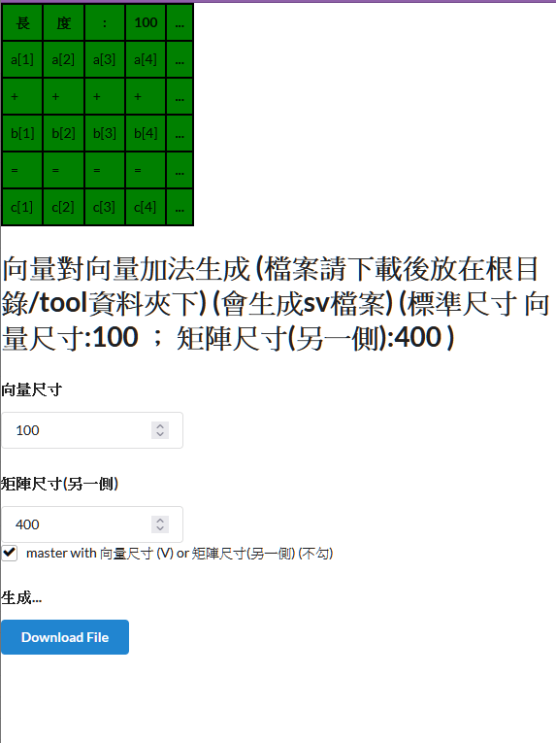
向量加法器-生成器

Slide 33
向量乘法器-單元IO
Vec1_32bit_array_len_100
X vec3_32bit_array_len_100
Vec2_32bit_array_len_100

Slide 34
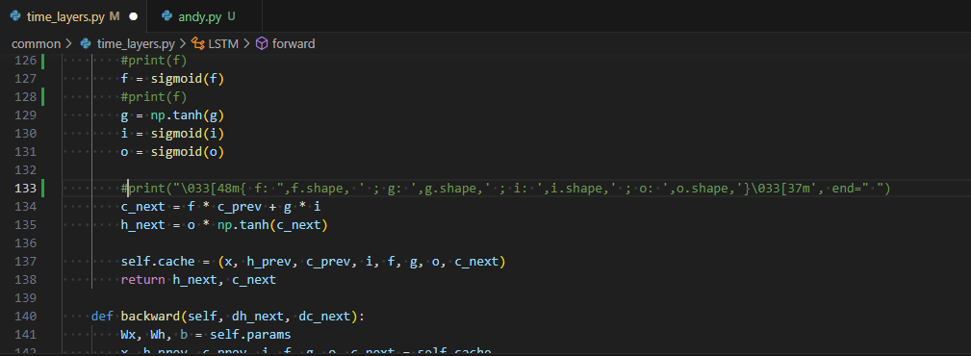
向量乘法器-接線

Slide 35
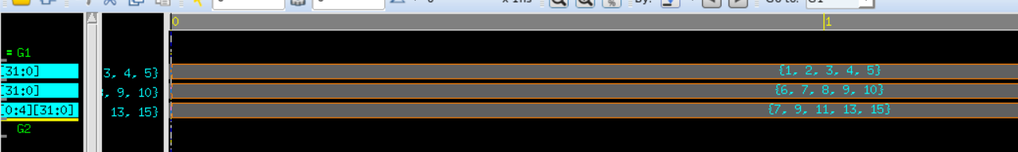
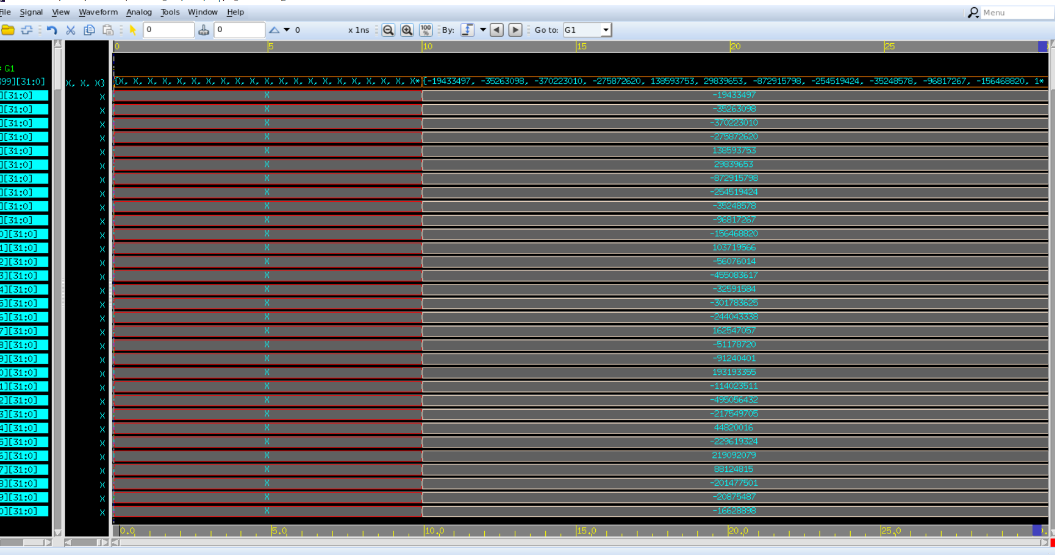
向量乘法器-驗證
TODO: 負數都沒測
Notes:
https://hackmd.io/oMyZzflqT6amguTnJ4ZhAw#add-b

Slide 36
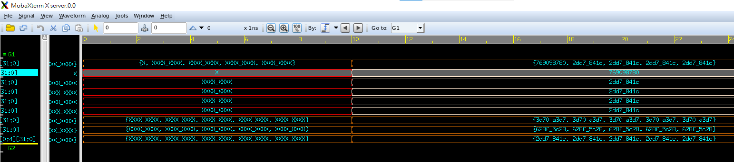
向量乘法器-會有誤差
取輸入測資
寫批次正解
寫批次TB
平均評估誤差
調節以下去minZE誤差
zoom_small變數為調節值

Slide 37
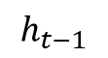
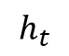
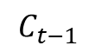
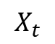
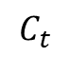
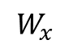
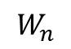
OVERVIEW
.
.
.
.
DRAM
$$C_{t}$$
$$C_{t−1}$$
1
$$W_{n}$$
LSTM
D
$$h_{t}$$
.
.
.
.
$$h_{t−1}$$
X
D
X
$$W_{x}$$
$$X_{t}$$
b
1
1
DRAM
BUS
Notes:
畫首圖

Slide 38
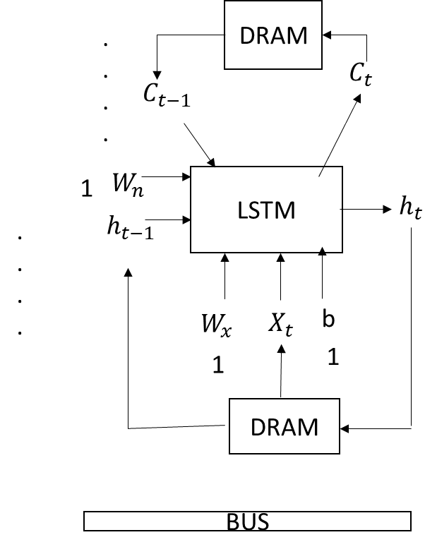

Slide 39
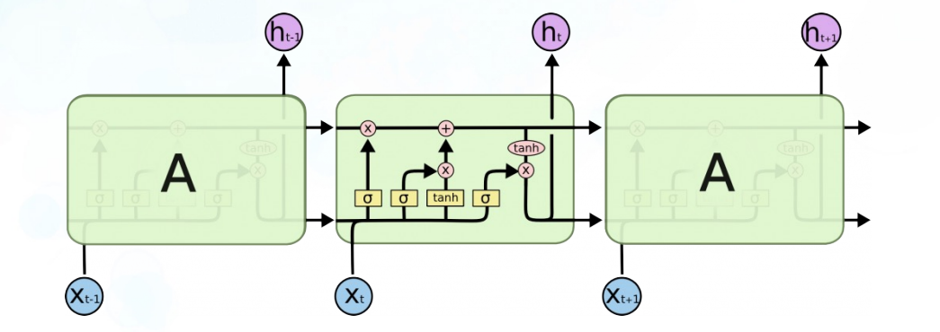
LSTM

Slide 40
LSTMPE
100個lstm和作一個PE

Slide 41
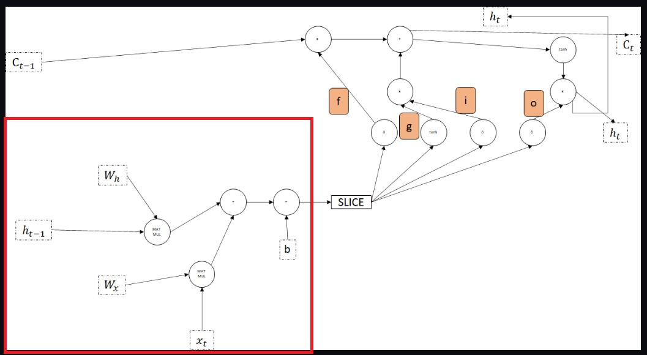
VMVMB

Slide 42
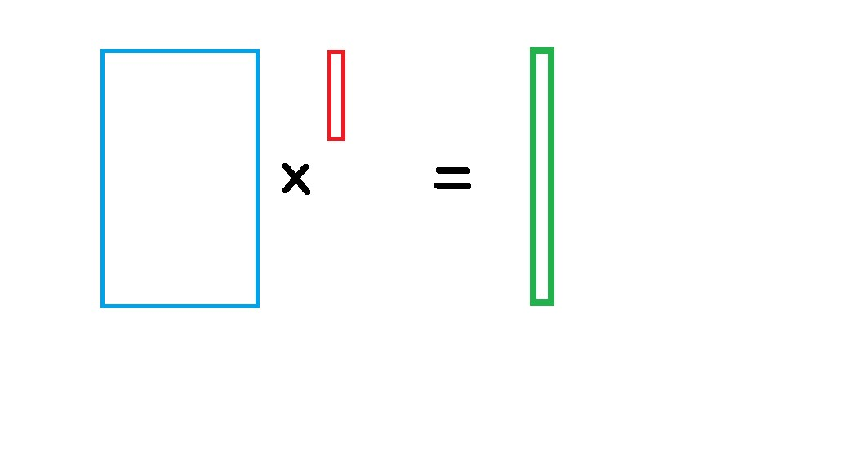
VMVMB
Wh,Wx
ht-1,xt
result
100
1
1
100
400
400

Slide 43
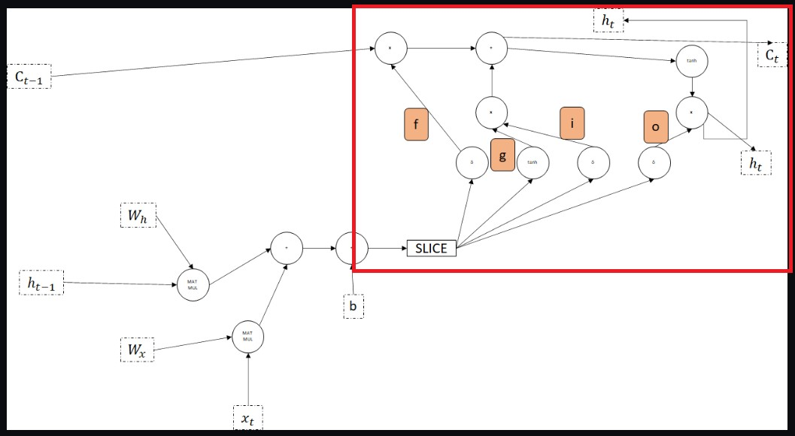
FGIO

Slide 44


Hardware mapping

Slide 45
Q/A

Slide 46

附錄
合成晶片使用
google open silicone

Slide 47

附錄
自製工具
效能矩陣格式化
網址:https://andythebreaker.github.io/chip/

Slide 48
參考資料
@misc{github, author={zachjs}, title={sv2v}, year={2023}, url={https://github.com/zachjs/sv2v/}, }

